Slide 1
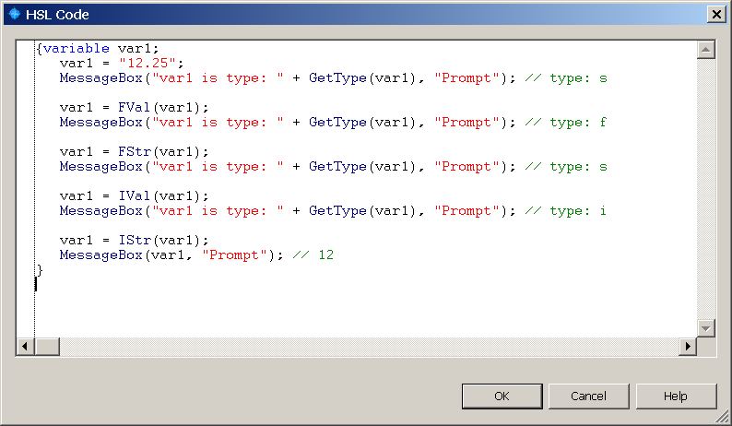

HSL
Hamilton Standard Language

Slide 2
HSL Introduction
HSL or Hamilton Standard Language is the underlying programming language that the STARline, NIMBUS, and VANTAGE are operated from
HSL is a C/C++ style programming language
We will be talking about what HSL can be used for and a little bit about basic HSL syntax

Slide 3
HSL Editor & Compiler
The HSL Method Editor is a separate program that can be located in “C:\Program Files\Hamilton\Bin\HxHslMetEd.exe”
The editor is basically a glorified text editor. In fact you can write an hsl file using a text editor.
Before an HSL file is run it has to be compiled (translated) into basic computer language. This is done by the “Microlab STAR Run” program that you are already familiar with.
Unlike a C/C++ program, the file is compiled just before it is run. This is done every time it is run.

Slide 4
HSL – What It Can Be Used For
You can use HSL to completely program the STAR, NIMBUS or VANTAGE
VENUS is actually a code generator that creates HSL code for you
The Run Engine (compiler) actually runs the HSL file, not your ‘.med’ file
It takes a lot of work to write a whole method so this is not commonly done. VENUS makes things easier.
HSL is usually used to create libraries

Slide 5
HSL Source Files
There are actually 2 HSL file types that you may run into:
  Files with a file extension of “.hsl” are known as header files while files with an extension of “.hs_” are known as Source files or implementation files
  Typically header files will contain just declarations of functions and variables while source files contain the actual code that is in the function (known as the function implementation)

Slide 6
Source Files – Why the Difference
There are three main reasons to do this:
  It allows another programmer to just look at the header file and know what the functions do so he can use them. He doesn’t need to know why they work.
  Sometimes you need to create additional functions for the functions in your header to work but, you may not want others to see them. Anything declared in the implementation file is not visible when the declaration file is included.
  It makes your code easier to manage and read

Slide 7
Coding Basics
Every line of code has to be ended with a semicolon (;)
Generally a new line is started after a semicolon. But this does not need to be done (just makes the code easier to read).
The space between lines is known as whitespace and does nothing
Use of a double forward slash (//) or a forward slash followed by a star (/*) indicates that the following information is a comment
All code needs to be contained within a code block (a set of curly brackets {…})

Slide 8
HSL Code Blocks
A code block is where the actual coding is done in the HSL files. In here you will see:
  Variable declarations
  Variable calculations
  Conditional processing (looping & if, else statements)
  Function calls
  Variety of other things.
Code blocks always begin and end with curly brackets { … }

Slide 9
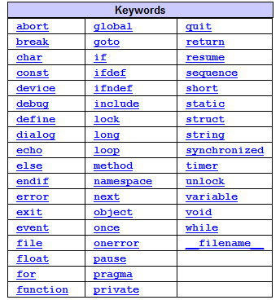
HSL Keywords
Keywords are reserved words that perform specific actions in HSL such as declaring variables & functions
You cannot name anything else with the same name as a keyword

Slide 10
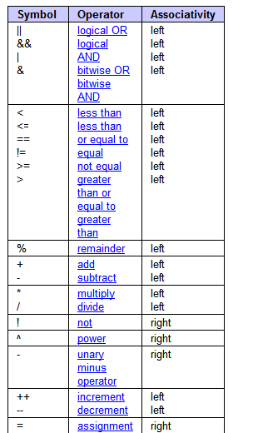
HSL Operators
Operators represent logical operations such as additions and subtractions
Operators can be used in variable calculations or in conditional processing (if, else statements) to compare data and make decisions
HSL has a full range of operators, including arithmetic, logical, bit-wise, and assignment operators

Slide 11
Variables & Objects
Variables are the basic components of source code.
They are used to store/represent information.
You can name a variable anything you want except for an hsl keyword.
You can perform calculations with variables just like in Venus.
Variables are objects but objects also include other types of representations:
  Sequences
  Files
  Devices
  Etc…

Slide 12
Variables - Declarations
To declare a variable you use the following code:
  variable myVariable;
Variables can also be initialized with an original value like this:
  variable myVariable(5); (integer declaration)
  variable myVariable(“Hello”); (string declaration)
  variable myVariable(hslTrue); (boolean declaration – true or false)
Variables always need to be declared before being used and at the start of your code block. They cannot be declared in the middle of your code.

Slide 13
Variables - Scope
As stated previously, variables need to be declared at the beginning of a code block. These variables are local to that code block. In other words, they only exist in that bit of code. There are a few other options however.
  Global variables are declared at the beginning of a source file with the keyword ‘global’. These variables can be used throughout all blocks of code – even in a different library or namespace.
  Static variables are similar to a global variable but are global to only that library/namespace. They are declared using the keyword ‘static’.
  All other variables are local to the code block in which they are declared.

Slide 14
Variables – Array Declarations
Arrays are not their own objects, rather you can have an array of any sort of object (e.g. array of variables, array of files, array of sequences, etc…)
To declare an array:
  Start by using the keyword of the type of the array (i.e. variable, file, sequence, etc…)
  Give it a name, just like a variable.
  Add a set of square brackets, [ ], right after the name.
  An empty set of brackets creates an empty, undeclared length, array.
  If you put a number in the brackets, [5], that declares the size of the array.
Unlike in VENUS, arrays in HSL are zero based, not one based

Slide 15
Variables – Array Declarations
A few examples:
variable theArrayOfVariables[ ]; (an empty array)
variable theArrayOfVariables[100]; (an array with 100 elements)
sequence theArrayOfSequences[ ]; (an array of sequences)

Slide 16
Conditional Processing – If, Else statements
HSL has the ability to compare things and make decisions. This is done with ‘If, Else’ statements.
These are used in the exact same manner as they are in Venus, so you are already familiar with them.
They can be nested within each other to check multiple conditions
They are somewhat more powerful than they are in Venus since you can check multiple conditions at the same time. This eliminates the need for multiple nested ‘If, Else’ statements.

Slide 17
If, Else Statements - Coding
‘If’ and ‘If, Else’ statements can take on the following appearance.
  If(var1 == 2)
    var2 = 5;
  Else
    var2 = 10;
Or this one starts a new code block for multiple instructions
  If(var1 == 2)
  {
    var2 = 5;
    var3 = 10;
  }

Slide 18
If, Else Statements - Coding
You can also check multiple conditions as follows:
  If(var1 == 5 && var2 == 10)
  {
    DoSomething();
  }
  Else
  {
    DoSomethingElse();
  }
The above checks if both expressions are true, you can also check other conditions such as ‘Or’ expressions. See the HSL Operators for which operators can be used.

Slide 19
Looping – For And While Statements
Just like in VENUS you can use loops in HSL to do certain things multiple times
There are 2 types of loops in HSL
  ‘for’ loops: These are used to do something a predetermined number of times.
  ‘while’ loops: These are used to do something while an expression is true. The expression is just like it is in ‘if, else’ statements.
There is also a ‘break’ command so that you can break your loop if a certain condition is met (just like in VENUS)

Slide 20
For Loops - Coding
For loops look like this:
  for(i = 0; i <= 100; i++)
  {
    …code that does something…
  }
The ‘i’ here is a loop variable.
It is originally assigned a value. In this case 0.
The second piece of the for statement tells the loop to keep going until i is greater than 100.
The last part of the statement increments the loop variable by 1 every time the loop is completed.

Slide 21
While Loops - Coding
While loops look like this:
  while(myVar < 2000)
  {
    …code that does something…
  }
The expression in the while loop is just like the expressions that are used in ‘If, Else’ statements.
Usually the code block of the loop performs some action to change the result of the expression.

Slide 22
Functions
Functions are chunks of code that perform repetitive tasks
Functions are analogous to sub-methods in Venus method files
Functions can, but don’t have to, take in variables and other objects as input
Similarly, functions can return a value of some sort (variable, sequence, file, etc.)
When called in your code a function call will look like this:
  myFunction(); (This function does not return anything)
  var1 = myFunction(); (this function returns a variable)
  var1 = myFunction(5); (this function returns a variable and has a variable as an input)

Slide 23
Functions – Declarations And Implementations
A function declaration is just a statement letting the compiler know what functions are in existence
A function implementation is the actual code of the function. This tells the compiler how the function actually works.
The declaration and implementation can be done at the same time but is usually split into separate parts. You will see the declaration in the header file (.hsl) and the implementation in the source file (.hs_).

Slide 24
Function Declarations
A function declaration looks like this:
  function myFunction(variable var1) variable
The parts of the declaration are as follows:
  function: This tells the compiler that this is a function
  myFunction: This is the name of the function (whatever you want to call it)
  variable: This first one is telling the compiler that ‘myFunction’ takes in one variable called ‘var1’. There can be multiple type declarations here!
  variable: The second variable declaration is telling the compiler and the programmer that this function returns a variable type object
  The variable declarations can be replaced with any type of object, e.g. sequence, file, etc… (see keywords for more)

Slide 25
Function Declarations - Advanced
A function does not have to return a variable. Some functions return other objects such as sequences or files while other functions can return nothing at all (this is marked by the keyword void)
Sometimes you will see an “&” after the word variable in the list of passed in variables/objects:
  function myFunction(variable& var1) void
This ampersand is telling the compiler that the variable that is passed in is also passed out with a value that has potentially changed. This is called passing a variable by reference.
If there is no ampersand then the variable that is passed in is not changed by the function

Slide 26
Namespaces
A namespace is a way to protect the functions of your library/sourcecode.
This is a way to distinguish where a function came from.
  For instance, say you are using 2 libraries and they both contain a function called ‘myFunction’. The compiler would not be able to distinguish between the 2 and would produce an error. If a namespace is used for each library it provides the compiler with a way to know which ‘myFunction’ belongs where. Sort of like a last name.
Namespaces are declared using the ‘namespace’ keyword.
All the code belonging in the namespace has to be contained within opening and closing curly brackets.

Slide 27
Using Libraries in HSL & The Preprocessor
Just like in VENUS you can use other HSL libraries in your code so that you can access all of the functions that have already been created
Libraries are always included at the beginning of the source file
The preprocessor is used to include these files
The preprocessor is a ‘macro’ that runs before the source code is compiled. This allows the compiler to get instructions on what is needed for the code to compile correctly.

Slide 28
Preprocessor Syntax
Preprocessor commands are always prefaced with a ‘#’ sign
These are usually seen at the beginning of an HSL file but also sometimes at the end

Slide 29
HSL Syntax – Preprocessor Commands
Typically in HSL you will see 2 types of preprocessor commands:
  Include commands. These are used to tell the compiler that we are using some features from another HSL file (library).
  Inclusion Guards. These are used to tell the compiler to check whether a particular library is already included through some other bit of source code. This is important because trying to include the same library more than once will cause an error.

Slide 30
HSL Syntax – Preprocessor Commands
Include commands look like this:
  #include “HSLMthLib.hsl”
Inclusion guards look like this:
  #ifndef __HSLMthLib_hsl__
    #include “HSLMthLib.hsl”
  #endif
Or:
  #ifndef __HSLMthLib_hsl__
    #define “HSLMthLib.hsl”
    …More code inserted here…
  #endif

Slide 31
The ‘HSL_RUNTIME’ Inclusion Guard
In every library you will see a special inclusion guard that looks like this:
#ifndef HSL_RUNTIME
  Some code here
#endif
#ifdef HSL_RUNTIME
  Some code here
#endif
This is an inclusion guard that is checking to see if you are programming in VENUS or if the run engine is running
The library header will be presented in the ‘#ifndef’ section and the implementation will be presented in the ‘#ifdef’ section
This is here so that the actual commands are not run while you are programming in VENUS

Slide 32
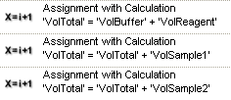
Embedded HSL – HSL in your Venus Methods
It is possible to add HSL code blocks directly into a VENUS method.
This is helpful for more complicated calculations that require multiple steps.
Before: (3.2 / 4.0)
Now:

Slide 33
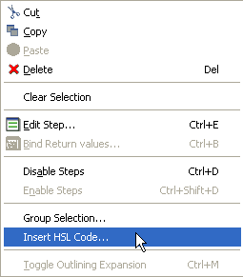
How To Insert HSL Code in your Method
To insert HSL code, right click in the Method Editor

Slide 34
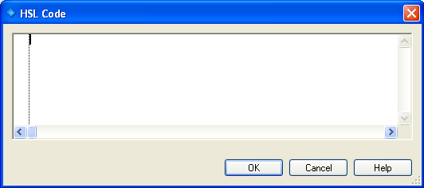
How To Insert HSL Code in your Method
The HSL Code window opens

Slide 35
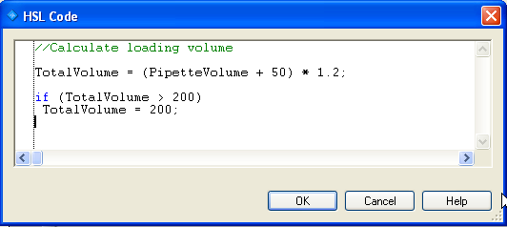
How To Insert HSL Code in your Method
In this function, you can do calculations, decisions, etc.
Please note that all NEW variables you create in the HSL code block are only valid within this block.

Slide 36
Adding Bitmaps To Your Libraries
Adding those little icons to your library commands (seen while programming in VENUS) is pretty easy
First draw a bit map. The dimensions need to be either 16 X 16 or 32 X 32 pixels.
Save the bitmap with the same name as the library in the library directory. That’s it, VENUS will do the rest and automatically load the icon when you include that library.
To create a separate picture for a particular function, save the bit map with the library name and then the function name separated with a period (libraryname.functionname.bmp)

Slide 37
Adding A Help File For Your Library
Adding a help file for your library is just as easy as adding an icon
VENUS help files are CHM file structures
To create CHM file you just need a CHM editor, you can find lots of free editors on the web
You can either create your file in here or you can write it in word and then use the CHM Editor to translate it
Save the help file with the same name as the library in the library folder and just like bitmaps, VENUS does the rest
It is highly recommended that you do create help files for your library. Nobody else but you can support it otherwise.

